Slide 1
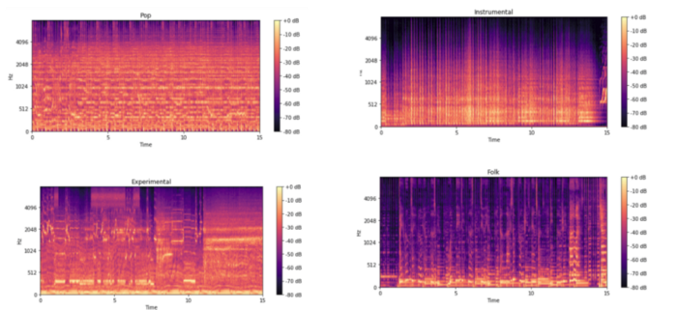
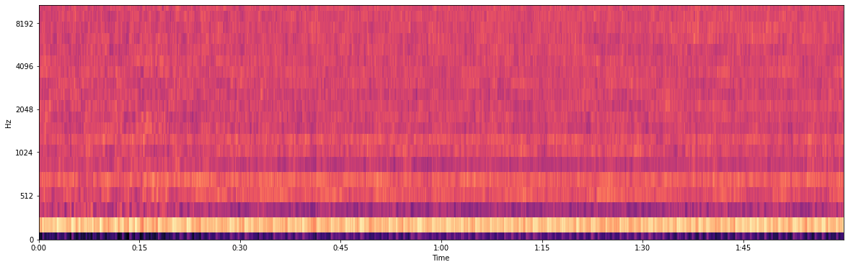
spectrogram
A spectrogram is a visual representation of audio across frequency and time dimension. CNN makes sense since spectrogram of a song are kind of like an image, each with their own distinct patterns.
different music have noticeable differences in their mel-spectrogram

Slide 2
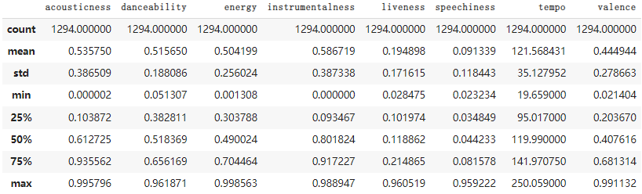
Music features

Slide 3
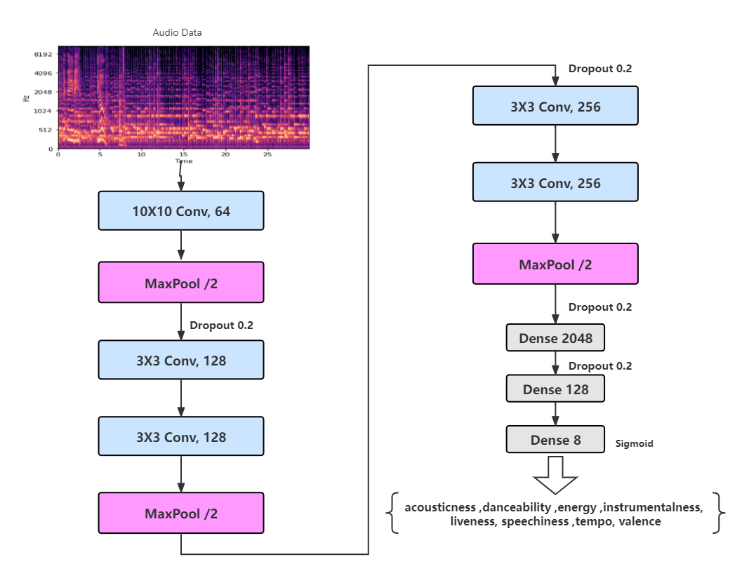
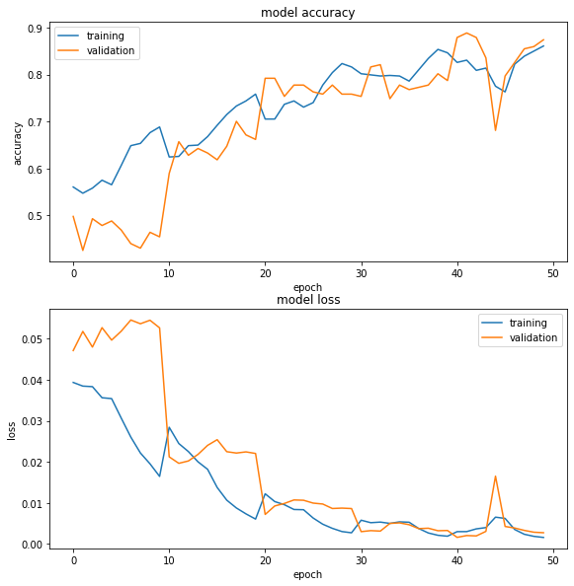
Multioutput Regression Model

Slide 4

Visualization Network

